Slide 1
Heap & Priority Queue

Slide 2
Why study Heapsort?
It is a well-known, traditional sorting algorithm you will be expected to know
Heapsort is always O(n log n)
  Quicksort is usually O(n log n) but in the worst case slows to O(n²)
  Quicksort is generally faster, but Heapsort is better in time-critical applications.

Slide 3
Idea
Store N elements in a binary heap tree.
Perform delete_Max (delete largest element) operation N times, storing each element deleted from the heap into another array.
Copy back the array.
  Not very efficient to use two arrays.
  Improvement – use single array for the binary heap and the sorted elements

Slide 4
What is a “heap”?
A heap is a Balanced left-filled binary tree T that stores a key-element pairs at its internal nodes.
It satisfies following properties:
  MinHeap: key(parent) ≤ key(child)
    OR
  MaxHeap: key(parent) ≥ key(child)

Slide 5
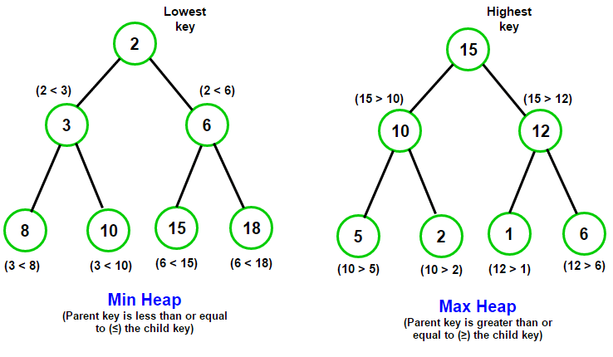
Heaps

Slide 6
Balanced binary trees
Recall:
  The depth of a node is its distance from the root.
  The depth of a tree is the depth of the deepest node.
A binary tree of depth n is balanced if all the nodes at depths 0 through n-2 have two children.
n-2
n-1
n
Balanced
Balanced
Not balanced

Slide 7
Left-justified binary trees
A balanced binary tree is left-justified if:
  all the leaves are at the same depth, or
  all the leaves at depth n+1 are to the left of all the nodes at depth n.
Left-justified
Not left-justified

Slide 8
Plan
First, we will learn how to turn a Balanced Left Justified Binary tree into a heap.
Next, we will learn how to turn a binary tree back into a heap after it has been changed in a certain way.
Finally we will see how to use these ideas to sort an array.

Slide 9
Construct a MaxHeap: Heapify
Given a node that does not have the heap property, you can give it the heap property by exchanging its value with the value of the larger child
12
14
8
14
8
12
Blue node does not have heap property
Blue node has heap property
This is sometimes called Heapify
Notice that the child may have lost the heap property

Slide 10
Step 1 : Constructing a heap
A tree consisting of a single node is automatically a heap.
We construct a heap by adding nodes one at a time:
  Add the node just to the right of the rightmost node in the deepest level.
  If the deepest level is full, start a new level.
Examples:
Add a new node here
Add a new node here

Slide 11
Constructing a heap II
Each time we add a node, we may destroy the heap property of its parent node.
To fix this, we heapify.
But each time we heapify, the value of the topmost node in the shift may increase, and this may destroy the heap property of its parent node.
We repeat the heapify process, moving up in the tree, until either
  We reach nodes whose values don’t need to be swapped (because the parent is still larger than both children), or
  We reach the root.

Slide 12
Constructing a heap III
8
8
10
10
10
8
8
5
1
2
3
10
10
12
8
5
12
5
10
5
12
8
8

Slide 13
Other children are not affected
12
12
14
10
5
14
5
12
5
8
14
8
10
8
10
The node containing 8 is not affected because its parent gets larger, not smaller.
The node containing 5 is not affected because its parent gets larger, not smaller.
The node containing 8 is still not affected because, although its parent got smaller, its parent is still greater than it was originally.

Slide 14
A sample heap
Here’s a sample binary tree after it has been heapified.
25
22
17
19
22
14
15
18
14
21
3
9
11
Notice that heapified does not mean sorted
Heapifying does not change the shape of the binary tree; this binary tree is balanced and left-justified because it started out that way

Slide 15
Step II: Get sorted array
As largest element is at the root of tree.
Remove the root element and make right most node at deepest level root node .
By doing so, tree may not be HEAP tree.
So, make it heap again (heapify).

Slide 16
Removing the root
Notice that the largest number is now in the root
Suppose we discard the root:
11
25
22
17
22
17
19
22
14
15
19
22
14
15
18
14
21
3
9
11
18
14
21
3
9
Remove the rightmost leaf at the deepest level and use it for the new root

Slide 17
The heapify method I
Our tree is balanced and left-justified, but no longer a heap
However, only the root lacks the heap property
11
22
17
19
22
14
15
18
14
21
3
9
We can heapify the root.
After doing this, one and only one of its children may have lost the heap property.

Slide 18
The heapify method II
Now the left child of the root (still the number 11) lacks the heap property.
22
11
17
19
22
14
15
18
14
21
3
9
We can heapify() this node.
After doing this, one and only one of its children may have lost the heap property.

Slide 19
The heapify method III
Now the right child of the left child of the root (still the number 11) lacks the heap property:
22
22
17
19
11
14
15
18
14
21
3
9
We can heapify() this node.
After doing this, one and only one of its children may have lost the heap property —but it doesn’t, because it’s a leaf.

Slide 20
The heapify method IV
Our tree is once again a heap, because every node in it has the heap property.
22
22
17
19
21
14
15
18
14
11
3
9
Once again, the largest (or a largest) value is in the root.
We can repeat this process until the tree becomes empty.
This produces a sequence of values in order largest to smallest.

Slide 21
Sorting
What do heaps have to do with sorting an array?
Here’s the neat part:
  Because the binary tree is balanced and left justified, it can be represented as an array.
  All our operations on binary trees can be represented as operations on arrays.
  To sort:
    heapify the array;
    while the array isn’t empty {
    remove and replace the root;
    reheap the new root node;
    }

Slide 22
Mapping into an array
25
22
17
19
22
14
15
18
14
21
3
9
11
0 1 2 3 4 5 6 7 8 9 10 11 12
25
22
17
19
22
14
15
18
14
21
3
9
11
Notice:
  The left child of index i is at index 2*i+1
  The right child of index i is at index 2*i+2
  Example: the children of node 19 ( index 3) are 18 (index 7) and 14 (index 8)

Slide 23
Removing and replacing the root
The “root” is the first element in the array.
The “rightmost node at the deepest level” is the last element
Swap them...
0 1 2 3 4 5 6 7 8 9 10 11 12
25
22
17
19
22
14
15
18
14
21
3
9
11
0 1 2 3 4 5 6 7 8 9 10 11 12
11
22
17
19
22
14
15
18
14
21
3
9
25
...And pretend that the last element in the array no longer exists—that is, the “last index” is 11 (9)

Slide 24
Reheap and repeat
Reheap the root node (index 0, containing 11)...
0 1 2 3 4 5 6 7 8 9 10 11 12
11
22
17
19
22
14
15
18
14
21
3
9
25
0 1 2 3 4 5 6 7 8 9 10 11 12
22
22
17
19
21
14
15
18
14
11
3
9
25
0 1 2 3 4 5 6 7 8 9 10 11 12
9
22
17
19
22
14
15
18
14
21
3
22
25
...And again, remove and replace the root node
Remember, though, that the “last” array index is changed
Repeat until the last becomes first, and the array is sorted!

Slide 25
Analysis I
Here’s how the algorithm starts:
    heapify the array;
Heapifying the array: we add each of n nodes
  Each node has to be Heapify, possibly as far as the root.
    Since the binary tree is perfectly balanced, shifting up a single node takes O(log n) time.
  Since we do this n times, heapifying takes n*O(log n) time, that is, O(n log n) time.

Slide 26
Analysis II
Here’s the rest of the algorithm:
    while the array isn’t empty {
    remove and replace the root;
    reheap the new root node;
    }
We do the while loop n times (actually, n-1 times), because we remove one of the n nodes each time.
Removing and replacing the root takes O(1) time.
Therefore, the total time is n times however long it takes the reheap method.

Slide 27
Analysis III
To reheap the root node, we have to follow one path from the root to a leaf node (and we might stop before we reach a leaf).
The binary tree is perfectly balanced.
Therefore, this path is O(log n) long:
  And we only do O(1) operations at each node.
  Therefore, reheaping takes O(log n) times.
Since we reheap inside a while loop that we do n times, the total time for the while loop is n*O(log n), or O(n log n).

Slide 28
Analysis IV
Here’s the algorithm again:
    heapify the array;
    while the array isn’t empty {
    remove and replace the root;
    reheap the new root node;
    }
We have seen that heapifying takes O(n log n) time.
The while loop takes O(n log n) time.
The total time is therefore O(n log n) + O(n log n).
This is the same as O(n log n) time.

Slide 29
Priority Queue

Slide 30
Abstract Data Type: Priority Queue
A priority queue is a collection of zero or more items,
  associated with each item is a priority
A priority queue has at least three operations
  insert(item i) (enqueue) a new item
  delete() (dequeue) the member with the highest
  priority
  find() the item with the highest priority
Note that in a priority queue "first in first out" does not apply in general.

Slide 31
Priority Queues: Assumptions
The highest priority can be either the minimum value of all the items, or the maximum.
  We will assume the highest priority is the minimum.
  Call the delete operation deleteMin().
  Call the find operation findMin().
Assume the priority queue has n members

Slide 32
Priority Queues: Implementation

Slide 33
Unsorted list: Array
1. Using an array arr.
  insert() adds the new item into next empty position in arr, in Θ(1).
  findMin() is Θ(n) in the worst case
  deleteMin() is Θ(n) in the worst case
    Θ(n) to find the minimum item
    and Θ (1) to move the last item to the position of the deleted element.

Slide 34
Unsorted list: Linked List
2. Using a linked list.
  insert() in Θ(1) with appropriate pointers.
  findMin() is Θ(n) since we may need to search the whole list.
  deleteMin() is Θ(n)
    In the worst case we may need to search the whole list, Θ(n)
    Delete item, Θ(1)

Slide 35
Priority Queue Implementations
Data
insert
DeleteMin
Structure
worst case
worst case
Heap
Θ(
lg n)
Θ(
lg n)
Unsorted
(array or linked list)
Θ(1)
Θ(n)
Sorted
(array or
linked list)
Θ(n)
Θ(1)
f00
pq <number>

Slide 36
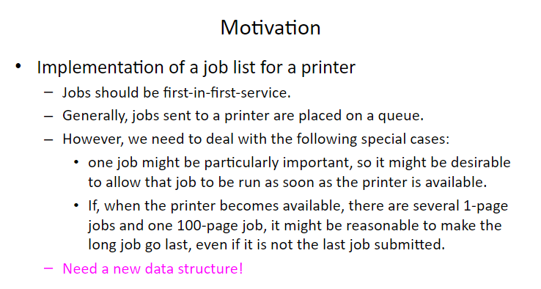

Slide 37
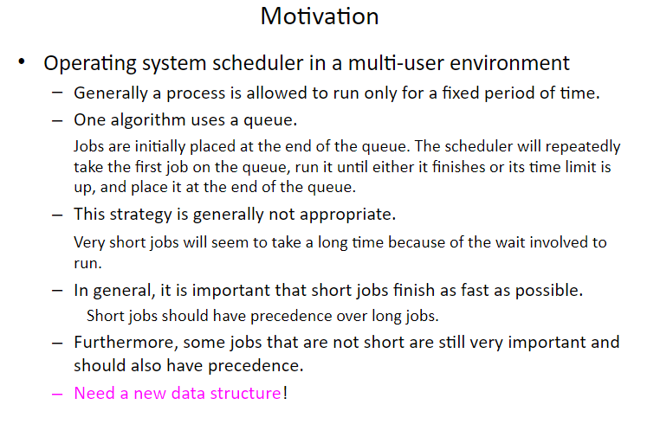

Slide 38
Sort the following using Heap
25 67 56 32 12 96 82 44

